Slide 1

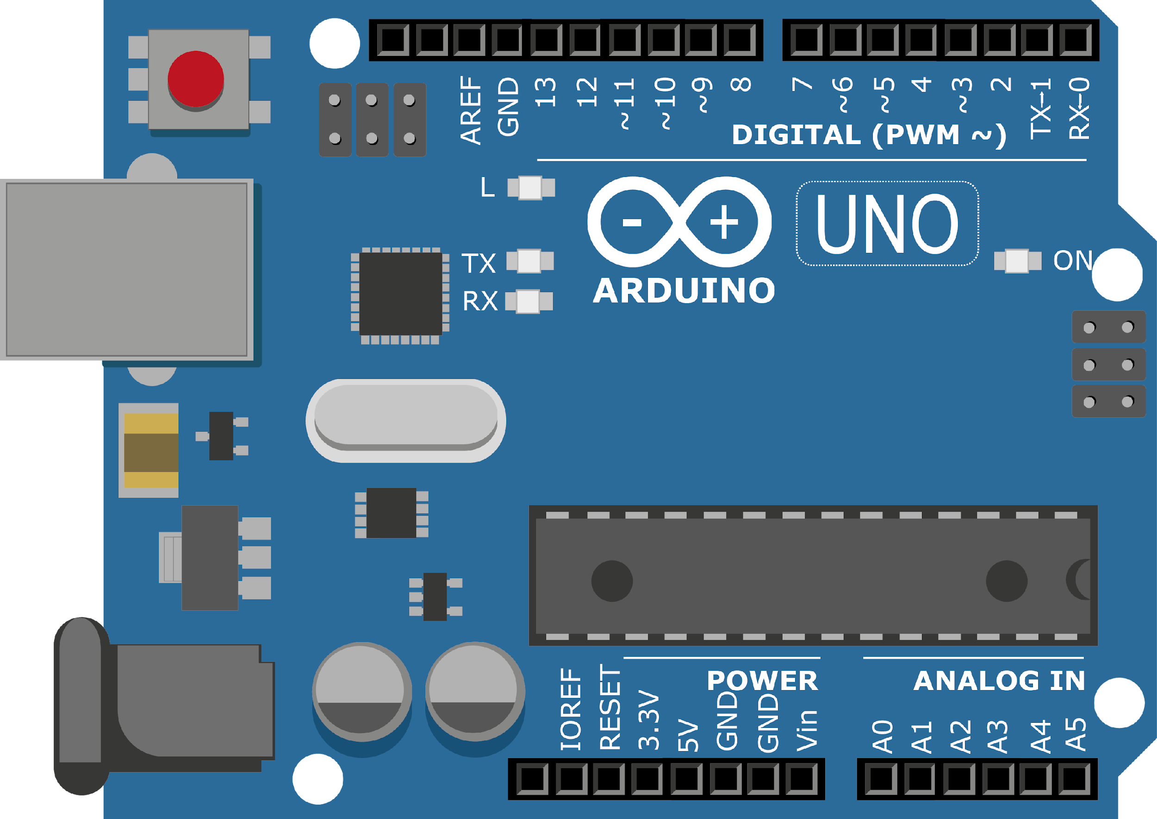
ARDUINO MASTER CLASS
16
Distance measurement using Ultrasonic sensor

Slide 2
16 AGENDA
02
03
01
Distance Measurement
Ultrasonic
Q & A

Slide 3
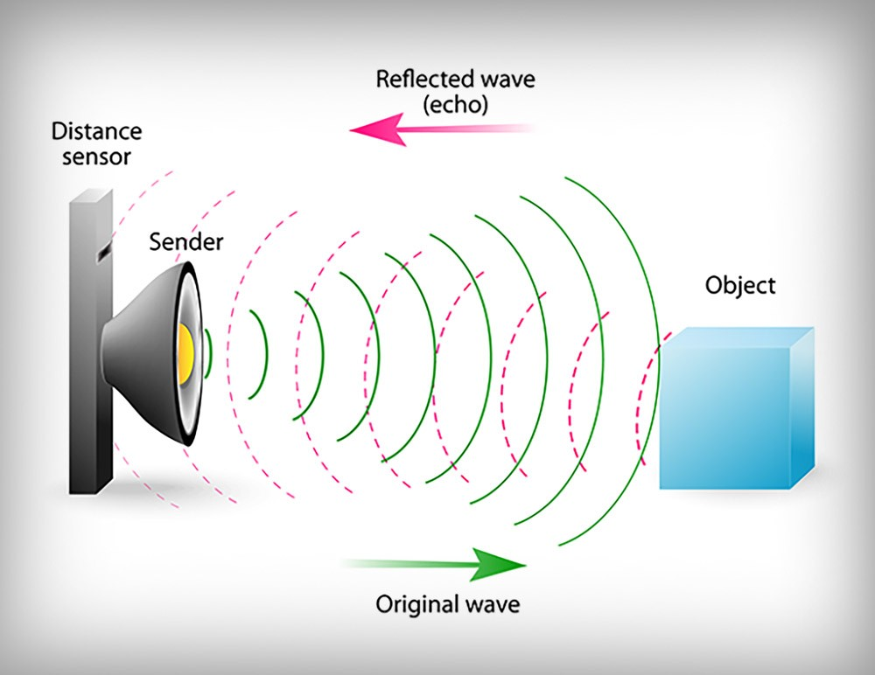
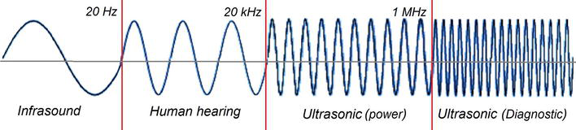
Ultrasound Technology
Ultrasound is sound waves with frequencies higher than the upper audible limit of human hearing. Ultrasound is not different from "normal" sound in its physical properties, except that humans cannot hear it.

Slide 4
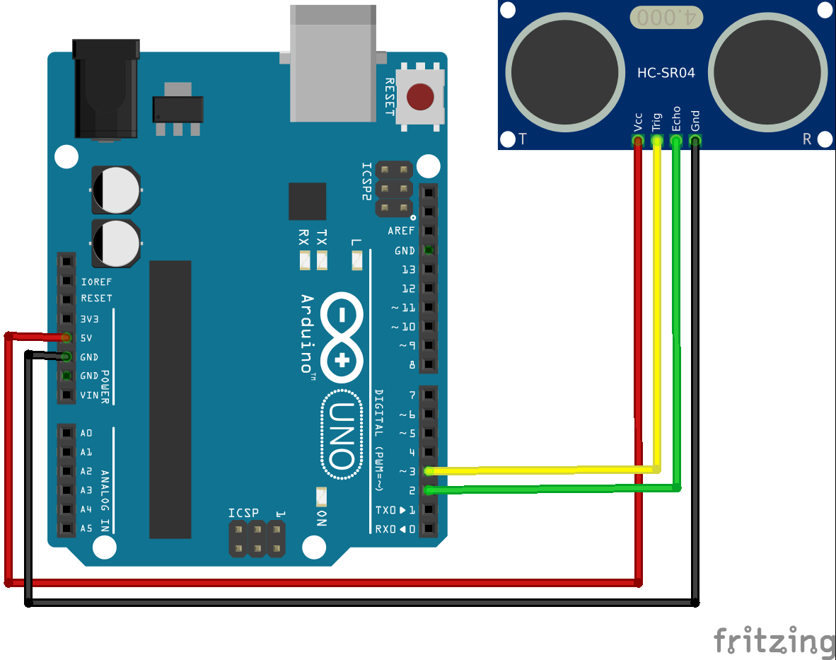
Ultrasonic with Arduino

Slide 5

INTERVIEW QUESTIONS
What is pass band?
What is cut-off frequency?
What is stop band?
Passband is the range of frequencies or wavelengths that can pass through a filter without being attenuated.
A stopband is a band of frequencies, between specified limits, in which a circuit, such as a filter or telephone circuit, does not let signals through, or the attenuation is above the required stopband attenuation level.
The frequency at which the response is -3dB with respect to the maximum response.

Slide 6

THANKS!

